Slide 2
Emerging Operators
Roundtable
Moderators:
Karl Guenther of Statement Limousine
Andy Hernandez of CTA Worldwide
AV Sponsor
Coffee Sponsor

Slide 3
Welcome & Thank You to Our Sponsors
AV Sponsor
Coffee Sponsors

Slide 4
Question #1
When is the right time to add new vehicles?
How do you buy vehicles smartly: going to the dealerships vs. a fleet dealer; sales tax requirements; buying at the right time – write-offs vs. cash management; ego buying cars; adding large vehicles; etc.
AV Sponsor

Slide 5
Question #2
How do you scale your business without overextending yourself?
How do you make the transition from mostly affiliate work to building
in-house work?
AV Sponsor

Slide 6
Question #3
What type of tech are you using in your business?
Industry and non-standard industry tech—not just reservation and dispatch—and other software and tech that you use daily.
AV Sponsor

Slide 7
Question #4
What are you doing to grow your brand awareness?
Marketing, networking (local), affiliate growth, etc.
AV Sponsor

Slide 8
Question #5
How do you add a chauffeur to your organization?
How do you train your chauffeurs while you’re still driving?
AV Sponsor

Slide 9
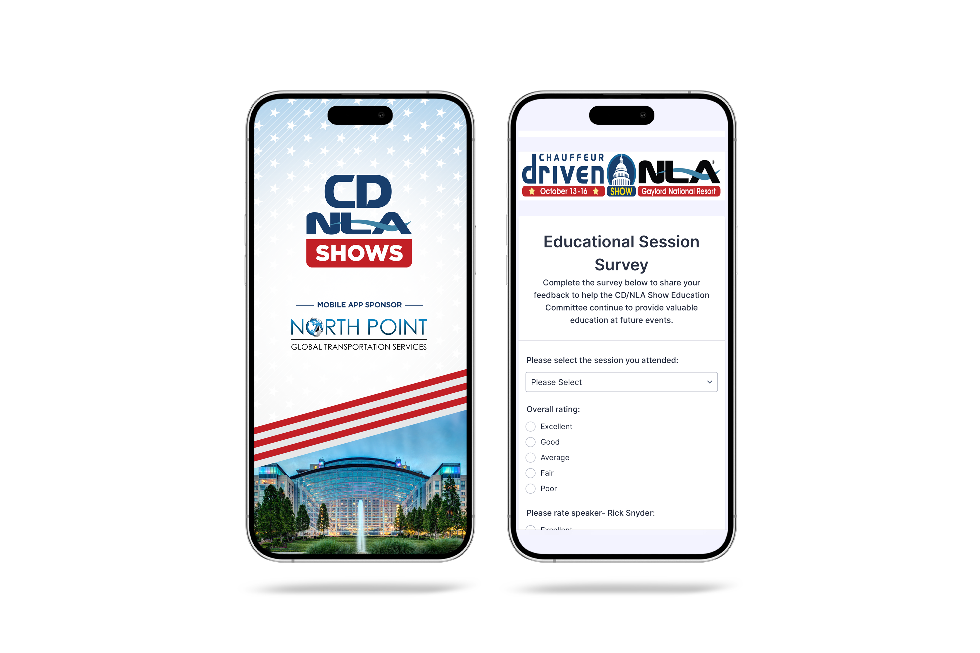
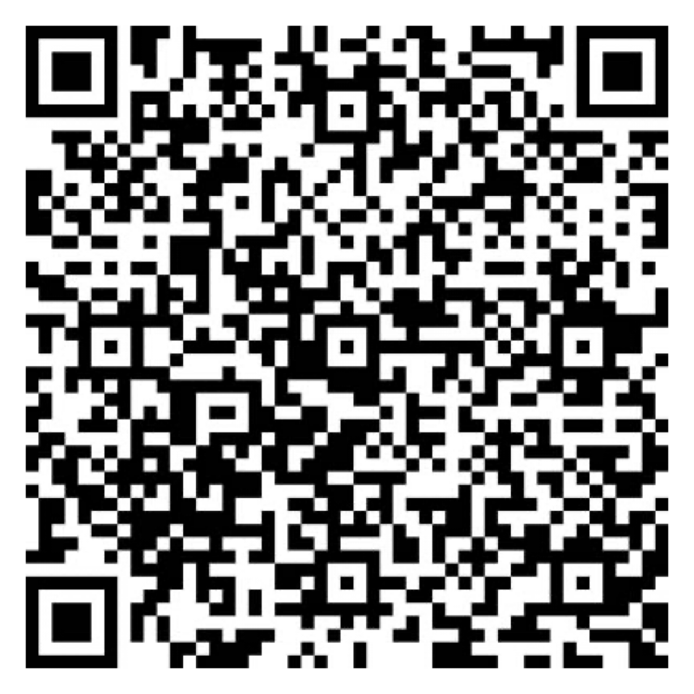
Let Us Know How
We Did!
Fill Out the Survey
AV Sponsor
Coffee Sponsor

Slide 10
Thank You for Joining Us!
AV Sponsor
Coffee Sponsor

